Slide 1
ActivitySim: An open platform for activity-based travel modeling
Ohio Travel Demand Model User Group
November 8, 2019

Slide 2
Today’s Topics
ActivitySim Overview
Getting Started with ActivitySim
Verification
Upcoming Features & Deployments
Q&A

Slide 3
ActivitySim Overview

Slide 4
ActivitySim Project Goals & Principles
Goals
Principles
Create an activity-based travel modeling platform
Unify best practices
Reduce development costs
Reduce maintenance costs
Collaborate
Open Source
User-friendly
Documented
Stable
Extensible / Flexible
Optimized
http://www.activitysim.org

Slide 5


Agency Partnership
Led by the Association of MPOs
All agencies participate in decision making and set annual development priorities
Pooled funding
New agencies are welcome
6 years of successful collaboration

Slide 6
ActivitySim Approach
Create agency partnership
Design based on an existing best practice model (MTC’s CT-RAMP)
Implement in Python using best software development practices and popular data science libraries (pandas, numpy)
Facilitate extensibility through modular design
Continuously integrate and test
Document comprehensively
Affiliated packages such as PopulationSim

Slide 7
Activity-Based Models
Activitysim overview and getting started:
https://activitysim.github.io/activitysim
Predict demand for travel
  Types and amounts of activities
  Destinations
  Travel modes
  Timing
Inputs
  Synthetic population
  Employment and land use
  Network performance (travel times, costs, transfers, etc.)
  Behavioral assumptions
Mostly discrete choice model components
Disaggregate – individual persons and households
Use Monte Carlo simulation

Slide 8
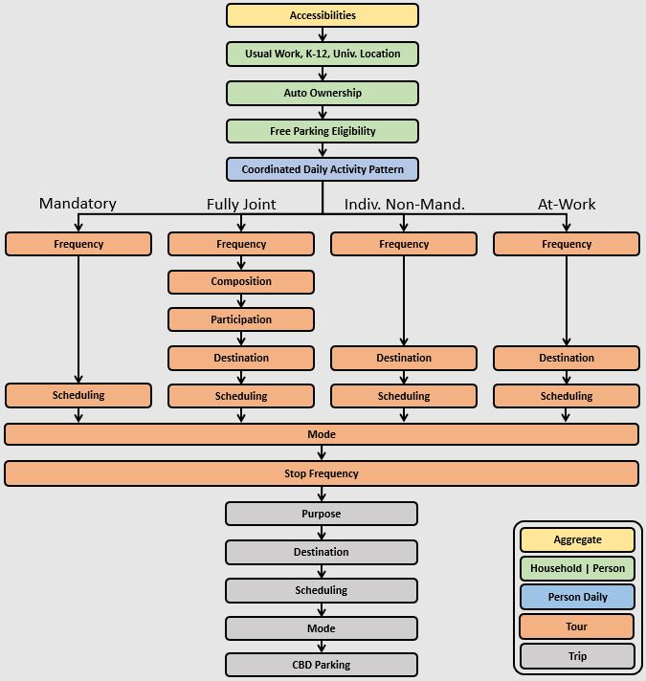
Structure and Components
Accessibilities
Work and school location
Auto ownership and parking
Daily activity patterns (intra-HH)
Individual tours, joint tours, and stops by activity purpose
  Frequency
  Composition
  Participation
  Scheduling
Tour and trip destination choice
Tour and trip mode choice

Slide 9
Features of Initial Implementation (MTC)
Detailed activity purposes
  Work
  School (grade, high, university)
  Shopping
  Social / recreational
  Escorting
  Eat out
  Other maintenance
  Other discretionary
Temporal resolution
  1 hour
Modes
  SOV (free, pay)
  HOV2 (free, pay)
  HOV3+ (free, pay)
  Walk
  Bike
  Local Bus (walk / drive access)
  Light-Rail (walk / drive access)
  Express Bus (walk / drive access)
  Bus Rapid Transit (walk / drive access)
  Heavy Rail (walk / drive access)
Spatial resolution
  TAZs
  MAZs (in development)

Slide 10
Features of Platform
Activitysim core components:
https://activitysim.github.io/activitysim/core.html
Utilities
  Expressed as user configurable Python / pandas / numpy expressions
Multiprocessing
  Configuration flexibility to run the processing of households in parallel
Pipelining
  Model can be started / stopped at any point (with stable random numbers)
Tracing and logging
  All calculations traced to CSVs for tagged households and ODs
Shadow pricing
  Iterative adjustment of work/school location choices to better match target data

Slide 11
Data Requirements
Works with open data formats
Table Data in CSV or binary HDF5 format
  Zone data (households, employment by type, parking costs, etc.)
  Synthetic households
  Synthetic persons
Network LOS skims in open matrix (OMX) format
  By mode and time-of-day
https://github.com/osPlanning/omx
https://www.hdfgroup.org/solutions/hdf5/

Slide 12
Implementation Requirements
Runs under Windows, Linux, or Mac
Size of problem drives requirements
  Population
  Number of zones, number of skims
Processes everything in RAM
  Makes use of chunking to process the population in manageable chunks of in-memory data
Is parallelized so more resources means faster runtimes
  More cores
  More memory

Slide 13
Current Runtime Performance
Full scale example
  7.5 million people, 1450 zones, 825 network skims
  Process chunks of households in parallel using Python’s multiprocessing library
Windows Server
  Intel Xeon E5 2.6GHz 28 core 224GB RAM
  Single process setup runs in 24 hours (100% sample)
  24 multiprocess setup runs in 2 hours 45 minutes (100% sample)
Cloud
  Linux 124 multiprocess setup
  Runs in 51 minutes and cost $16 (100% sample)

Slide 14
Getting Started with ActivitySim

Slide 15

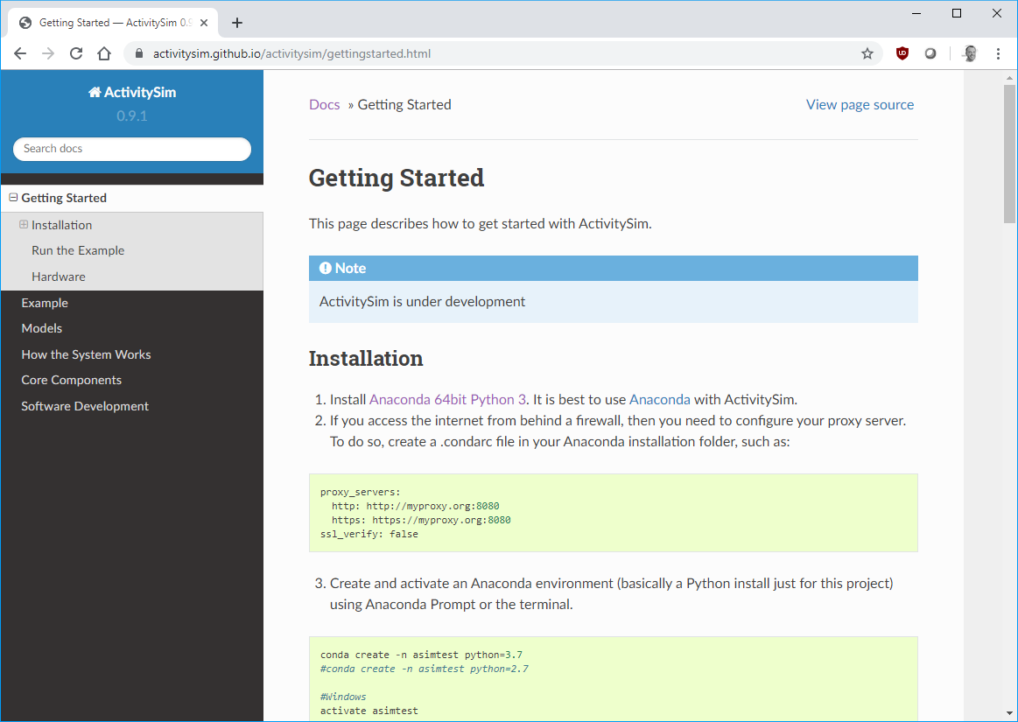
Installing
Get and install Anaconda 64bit Python 2 or 3
  Pre-built collection of performant Python libraries (and underlying C/C++)
Get and install other libraries
  using conda to ensure compatibility and performance
Get and install ActivitySim
  using pip to download the package from the Python Package Index
Activitysim getting started guide:
https://activitysim.github.io/activitysim/gettingstarted.html

Slide 16
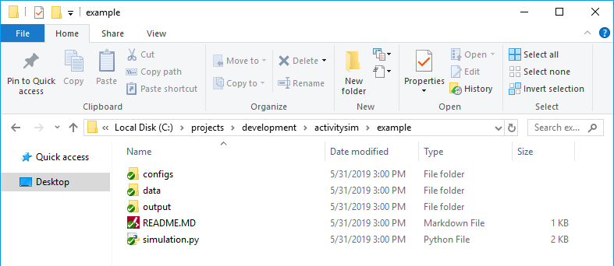
Configuring and Running
Folder and File Setup
  Configs: settings, expressions files, etc.
  Data: input data - land use, synthetic population, and skims
  Output: outputs folder
  simulation.py: main script to run the model (next slide)
Activitysim example model:
https://github.com/ActivitySim/activitysim/tree/master/example

Slide 17
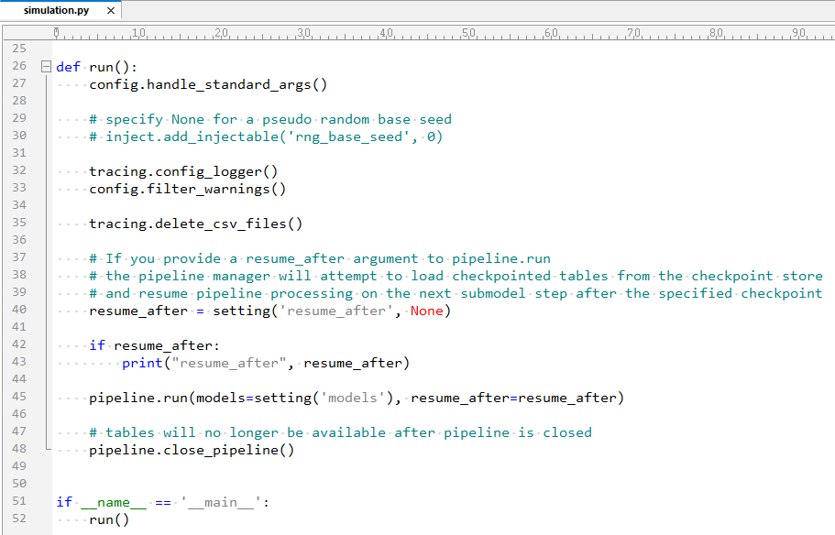
Configuring and Running
simulation.py
  Reads settings.yaml config file (next slide)
  Runs model steps defined in yaml
  Can restart model run at resume_after model step
  Run from the command line
  Specify config, data, and output directories for the scenario on the command line

Slide 18
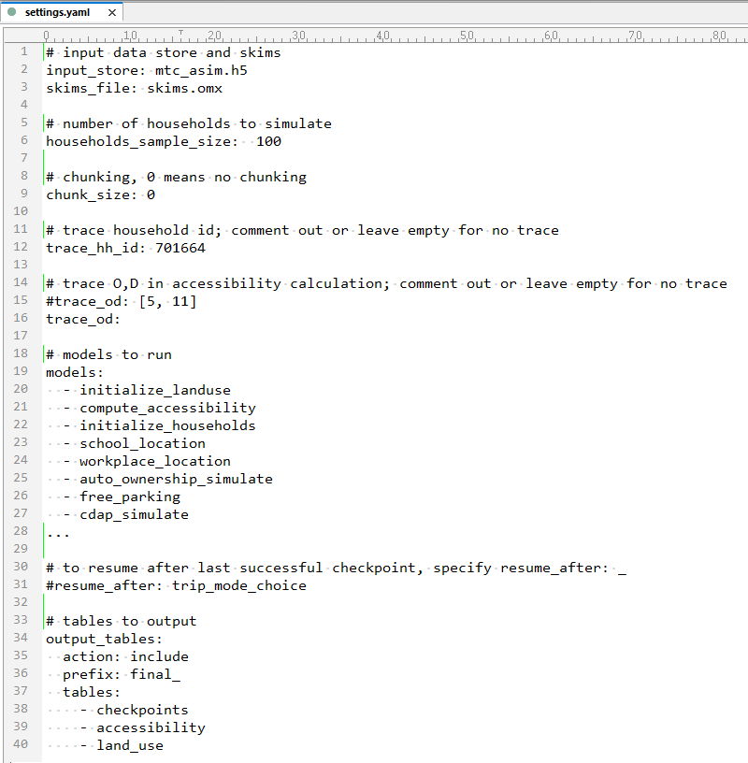
Configuring and Running
settings.yaml
  Input table data: zones, HHs, persons, etc.
  Skims OMX file
  HH sample size (or list of HH IDs to run)
  Chunking size for memory usage
  Trace HH or OD
  Models to run
  Resume at model option
  Pipeline tables to output at the end
  And other settings

Slide 19
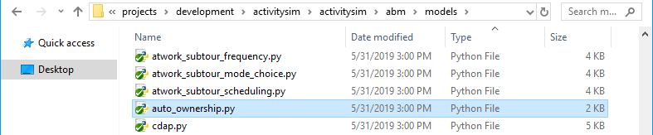
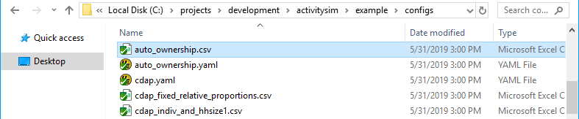
Auto Ownership Model Example
Example submodel components:
  Code: auto_ownership.py
  Config: auto_ownership.yaml
  Expressions: auto_ownership.csv
  Each described in more detail on the next slides
See submodel config files for all models:
https://activitysim.github.io/activitysim/abmexample.html#sub-model-specification-files

Slide 20
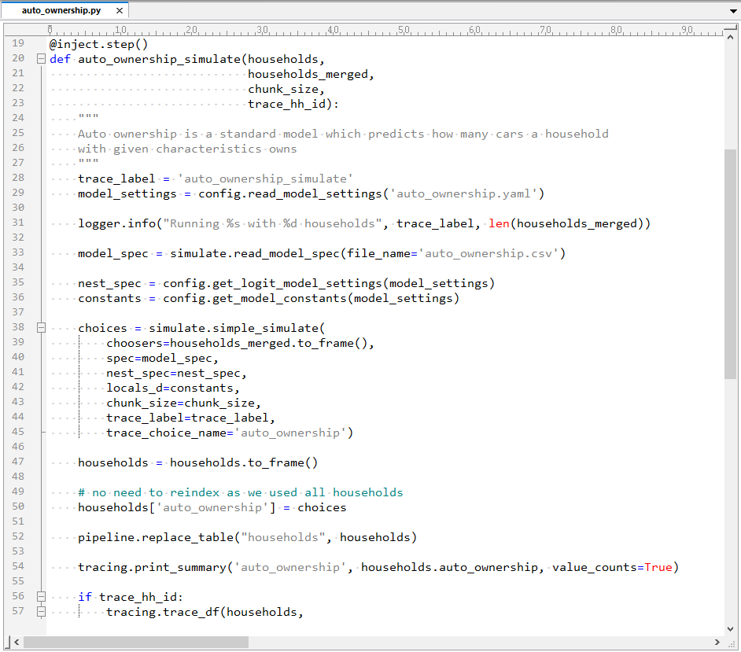
Auto Ownership Model Example
Code:
  @inject_step() is runnable model step in the settings.yaml models list
  Input households & households_merged table
  Reads yaml config file
  Reads model expressions specification
  Makes choices
  Sets households table auto_ownership column
  Replaces households table in the pipeline
  Traces calculations
households_merged is households, land_use, and accessibility table merged
https://github.com/ActivitySim/activitysim/blob/master/activitysim/abm/tables/households.py

Slide 21
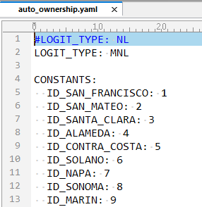
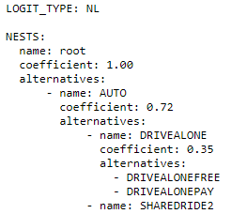
Auto Ownership Model Example
Config:
  Specifies submodel configuration options and is different for each submodel
  Specifies multinomial logit model structure
  Specifies named constants such as county codes to use in the expressions spec
  Model alternatives are specified in the expressions file (next slide)
Nesting structure is specified here as well if applicable, for example
https://github.com/ActivitySim/activitysim/blob/master/example/configs/trip_mode_choice.yaml

Slide 22
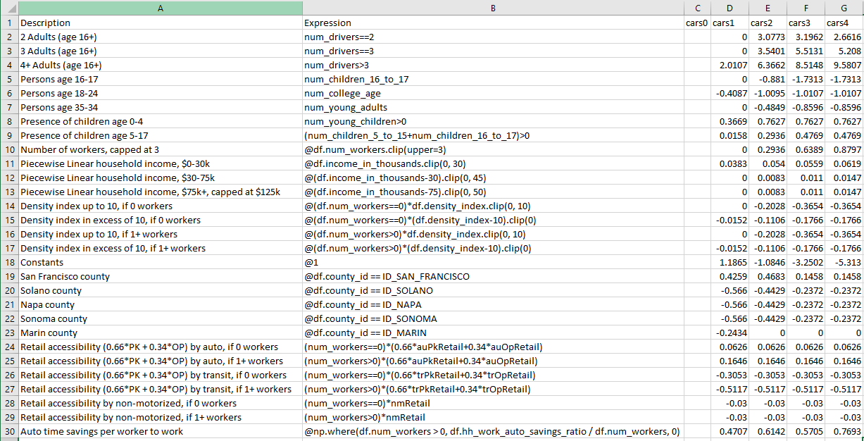
Auto Ownership Model Example
alternatives
auto_ownership.csv
Expressions Table:
  Each row is an expression
  Multiplies each expression value by the alternative coefficient and then sums down the column to get the alternative total utility
Expressions:
  Any valid Python / pandas / numpy code
  Can create new rows
  Data available from choosers table passed in (households_merged) and globals
  Can create pre/post model step processors to create additional variables (next slides)

Slide 23
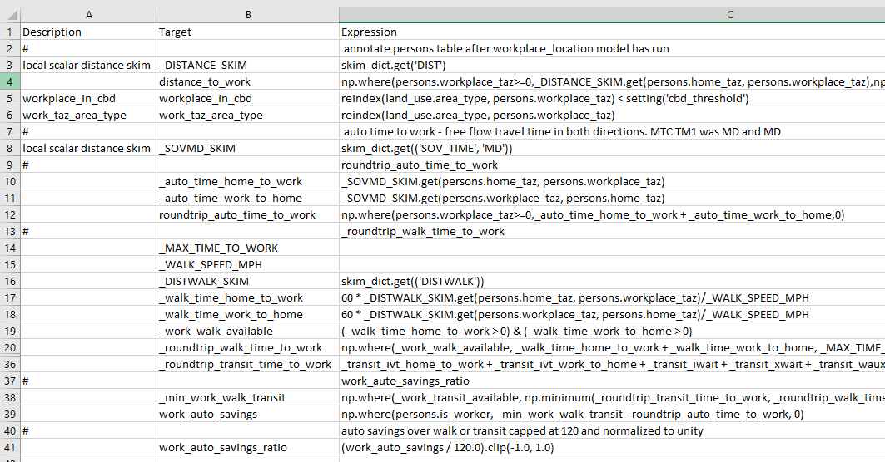
Auto Ownership Model Example
At the end of the workplace_location model step
Annotate persons table and then households table to add fields for later use
skims
land use
annotate_persons_workplace.csv

Slide 24
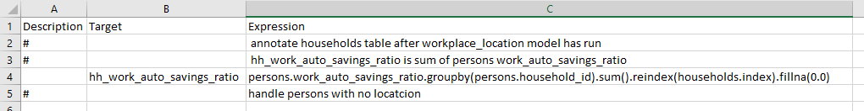
Auto Ownership Model Example
With persons work_auto_savings_ratio calculated
Calculate households hh_work_auto_savings_ratio
Store result on the households table for the auto ownership model since it uses the households table as the chooser table
annotate_households_workplace.csv
See the annotate_persons and annotate_households settings in workplace_location.yaml
https://github.com/ActivitySim/activitysim/blob/master/example/configs/workplace_location.yaml

Slide 25
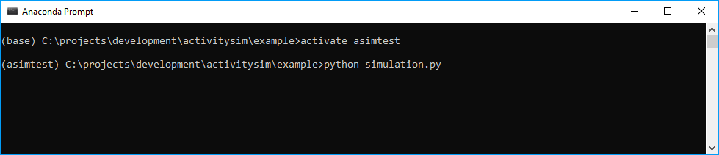
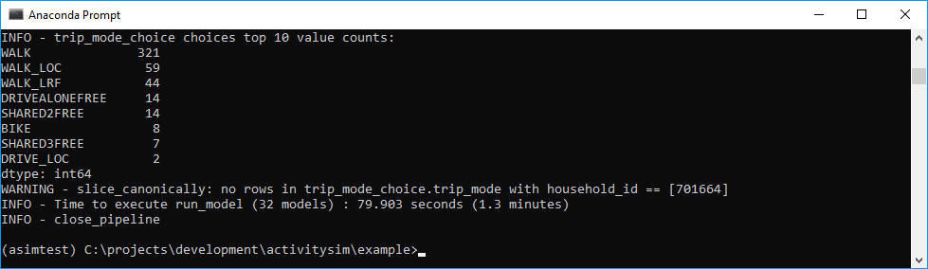
Run Model Example
Run:
  Open Anaconda Prompt
  Change to project directory
  Activate Anaconda environment
  Run simulation.py
  Optionally set config, data, and output folder locations if needed
Learn more about how activitysim works:
https://activitysim.github.io/activitysim/howitworks.html

Slide 26
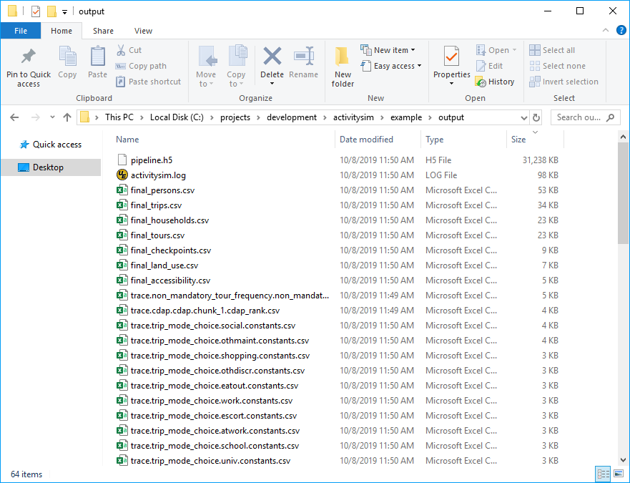
Outputs Example
Pipeline.h5 – all tables before and after each submodel (next slide)
Final_*.csv – final synthetic travel diary tables (next slides)
  Complete pipeline tables output (i.e. all data fields)
Trace*.csv – tracing of calculations for each model step for debugging (next slides)
  Tracing outputs broken out into parsable CSV files
Activitysim example data schema:
https://activitysim.github.io/activitysim/howitworks.html#data-schema

Slide 27
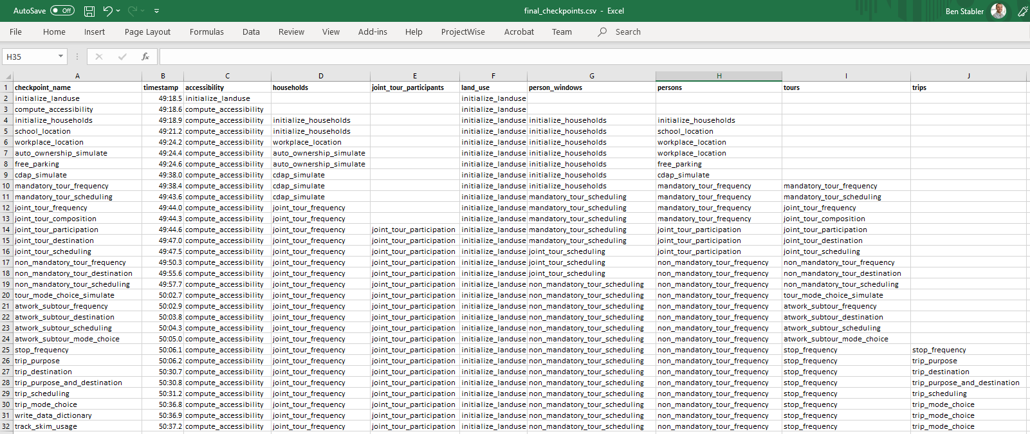
Outputs Example
Pipeline content is written to the final_checkpoints.csv table
List of all tables stored in the pipeline
Pipeline tables stored as Python pandas DataFrames for easy I/O in pandas

Slide 28
Outputs Example
Final_households.csv
  household_id
  TAZ
  SERIALNO
  PUMA5
  income
  hhsize
  HHT
  UNITTYPE
  NOC
  BLDGSZ
  TENURE
  VEHICL
  hinccat1
  hinccat2
  hhagecat
  hsizecat
  hfamily
  hunittype
  hNOCcat
  hwrkrcat
  h0004
  h0511
  h1215
  h1617
  h1824
  h2534
Final_households.csv (continued)
  h3549
  h5064
  h6579
  h80up
  num_workers
  hwork_f
  hwork_p
  huniv
  hnwork
  hretire
  hpresch
  hschpred
  hschdriv
  htypdwel
  hownrent
  hadnwst
  hadwpst
  hadkids
  bucketBin
  originalPUMA
  hmultiunit
  chunk_id
  income_in_thousands
  income_segment
  median_value_of_time
  hh_value_of_time
  Final_households.csv (continued)
  num_non_workers
  num_drivers
  num_adults
  num_children
  num_young_children
  num_children_5_to_15
  num_children_16_to_17
  num_college_age
  num_young_adults
  non_family
  family
  home_is_urban
  home_is_rural
  auto_ownership
  hh_work_auto_savings_ratio
  num_under16_not_at_school
  num_travel_active
  num_travel_active_adults
  num_travel_active_preschoolers
  num_travel_active_children
  num_travel_active_non_preschoolers
  participates_in_jtf_model
  joint_tour_frequency
  num_hh_joint_tours

Slide 29
Outputs Example
Final_persons.csv
  person_id
  household_id
  age
  RELATE
  ESR
  GRADE
  PNUM
  PAUG
  DDP
  sex
  WEEKS
  HOURS
  MSP
  POVERTY
  EARNS
  pagecat
  pemploy
  pstudent
  ptype
  Padkid
  age_16_to_19
  age_16_p
  adult
  male
  female
Final_persons.csv (continued)
  has_non_worker
  has_retiree
  has_preschool_kid
  has_driving_kid
  has_school_kid
  has_full_time
  has_part_time
  has_university
  student_is_employed
  nonstudent_to_school
  is_student
  is_gradeschool
  is_highschool
  is_university
  school_segment
  is_worker
  home_taz
  value_of_time
  school_taz
  distance_to_school
  roundtrip_auto_time_to_school
  workplace_taz
  distance_to_work
  workplace_in_cbd
  work_taz_area_type
  Final_persons.csv (continued)
  roundtrip_auto_time_to_work
  work_auto_savings
  work_auto_savings_ratio
  free_parking_at_work
  cdap_activity
  cdap_rank
  travel_active
  under16_not_at_school
  has_preschool_kid_at_home
  has_school_kid_at_home
  mandatory_tour_frequency
  work_and_school_and_worker
  work_and_school_and_student
  num_mand
  num_work_tours
  num_joint_tours
  non_mandatory_tour_frequency
  num_non_mand
  num_escort_tours
  num_eatout_tours
  num_shop_tours
  num_maint_tours
  num_discr_tours
  num_social_tours
  num_non_escort_tours

Slide 30
Outputs Example
Final_tours.csv
  tour_id
  person_id
  tour_type
  tour_type_count
  tour_type_num
  tour_num
  tour_count
  tour_category
  number_of_participants
Final_tours.csv (continued)
  destination
  origin
  household_id
  start
  end
  duration
  tdd
  composition
  tour_mode
  atwork_subtour_frequency
  parent_tour_id
  stop_frequency
  primary_purpose
Final_trips.csv
  trip_id person_id
  household_id
  tour_id
  primary_purpose
  trip_num
  outbound
  trip_count
  purpose
  destination
  origin
  depart
  trip_mode

Slide 31
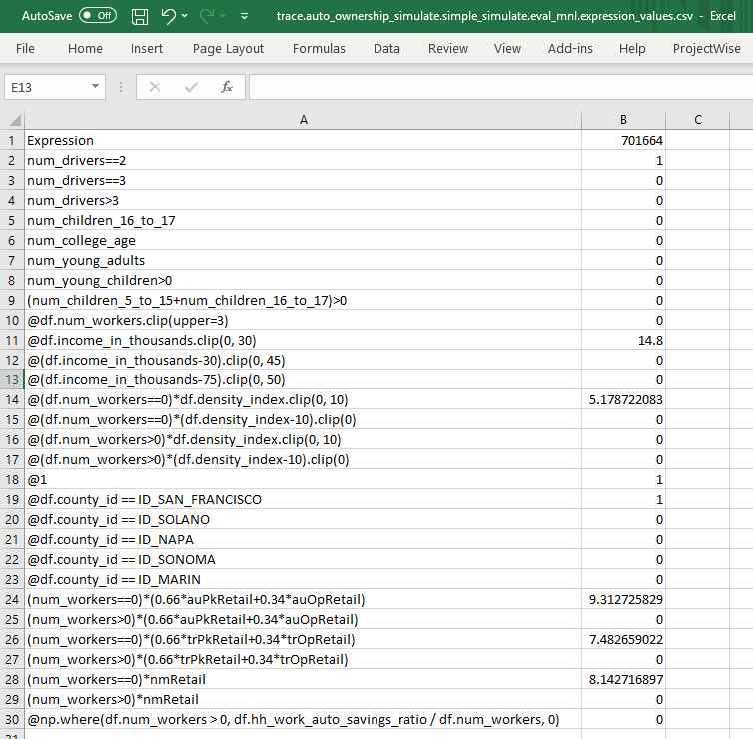
Outputs Example
Trace results
  For trace HH ID
  expression_values.csv

Slide 32
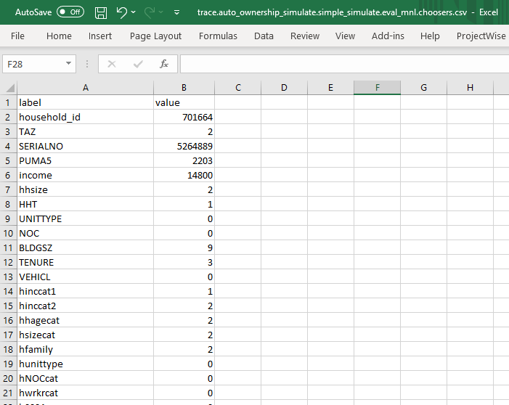
Outputs Example
Trace results
  For trace HH ID
  choosers.csv

Slide 33
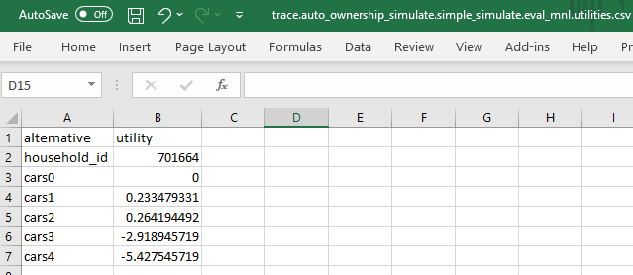
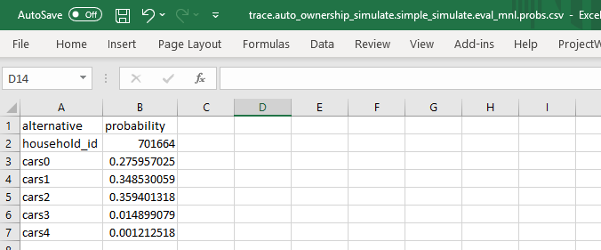
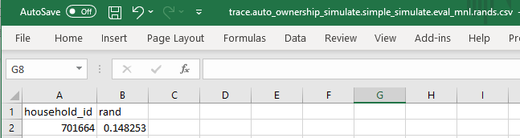

Outputs Example
Trace results
  For trace HH ID
  utilities.csv
  probs.csv
  rands.csv
  choices.csv

Slide 34
Verification

Slide 35
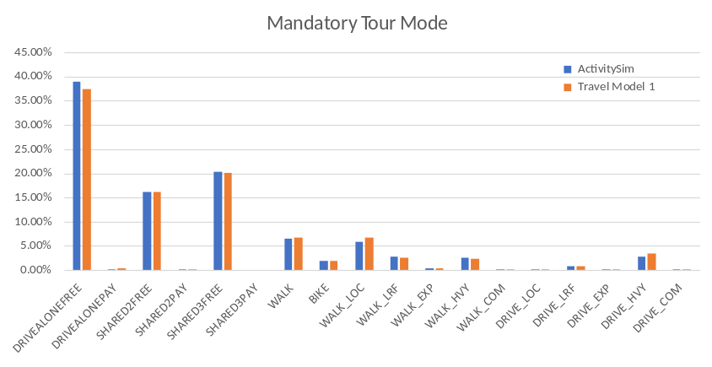
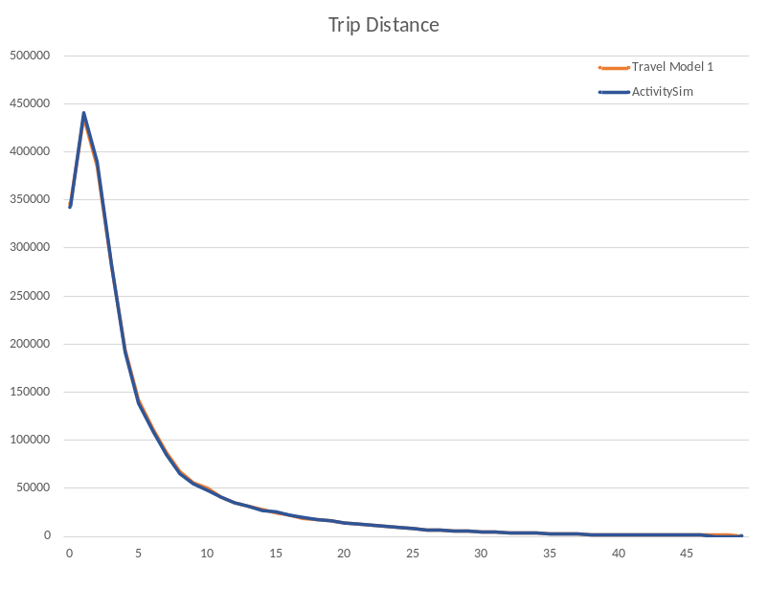
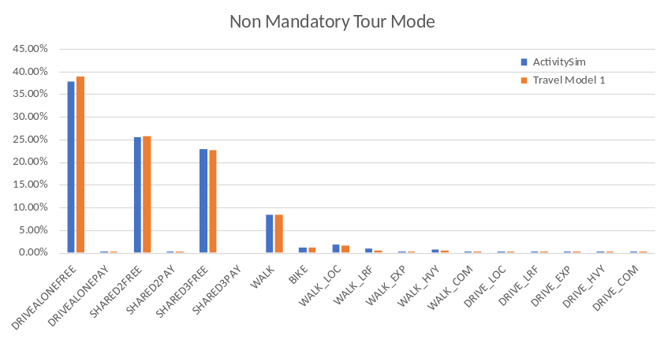
Verification of Results
All sub-models verified for goodness-of-fit
Full verification setup and results:
https://github.com/ActivitySim/activitysim/wiki/Verification

Slide 36
Upcoming Features & Deployments

Slide 37
Upcoming Features
Fall 2019 Work Order
Strategic Development and Contribution Plan
Support for Two Zone Systems
Input and Output Improvements
Support for Modeling TNCs and For-Hire Vehicles
Model Developer Tutorial
Performance Tuning
PopulationSim Integration
Model Estimation Mode
Support for Three Zone Systems and Transit Virtual Path Building
https://github.com/ActivitySim/activitysim/wiki/Phase-5-Scope-of-Work

Slide 38
Deployments
Full scale included example
  MTC (San Francisco region) CT-RAMP Design ABM
In-progress
  ARC (Atlanta region) CT-RAMP Design ABM
Starting soon
  SEMCOG (Detroit region) New ABM
  MWCOG (Washington DC region) New ABM
Others in discussion

Slide 39

Contact
Ben Stabler, GISP
DIRECTOR
Ben.Stabler@rsginc.com
http://www.activitysim.org

